Slide 1
Avoiding Phishing Attack on Online Voting System Using Visual Cryptography 08_Kavya Sudheer MCA-S4

Slide 2
RELEVANCE OF THE TOPIC Elections are conducted everywhere, but voters must go to polling booth to caste vote. Election process is very complex and requires a lot of things to be done prior to voting. There are a lot of arrangements to be done. It includes a lot of manual work. In organization voter must be present at voting center to caste vote. So the plan is to make the voting process secure and effective one. Visual cryptography adds security in voting. It is important to implement such systems this will reduce manpower, make voting easy to use and efficient.

Slide 3
DESCRIPTION The main aim of using visual cryptography in voting system is to give provision for casting vote for internal decisions in an organization. It is flexible enough to cast vote from remote places. To maintain the security we are using CAPTCHA code and Image Share technology. The proposed method offers anonymity of voter identity, while keeping the votes private, and the election transparent and secure.

Slide 4
OBJECTIVE OF THE TOPIC Visual cryptography is very secure scheme and it is used for privacy, that allows the encryption of secret image or data by transferring it into the secure share and the decryption is done without any computation devices. Visual Cryptography is a secret sharing method in which an image is divided into shares. The information about the original photocopy (Voter Password) will be acknowledged only after stacking sufficient number of shares. Visual Cryptography in E-voting aims that providing the facility to voters to cast their vote without going to the voting center for the elections that are conducted. The election will go on with good security measures because the voter can only vote for the candidate only if he logged into the system by entering the correct CAPTCHA code that is got by merging the two shares. Thus our E-voting provides two way securities to the voting system.

Slide 5
Existing System The Existing System of Election is running manually. The Voter has to Visit to Booths to Vote a Candidate so there is wastage of Time. The Voter has to manually register into the Voter List. Also Vote counting has to be done manually.All the Information of the Voter or Candidate is to be filling in manually. Voter must be present in his/her Constituency to give his/her Vote. There are Electronic Voting Machines used which Takes More Cost. The voting system previously being used by the Government is a paper based system, in which the voter simply picks up ballots sheets from electoral officials, tick off who they would like to vote for, and then cast their votes by merely handing over the ballot sheet back to electoral official. Some of the existing systems are: i. Paper-based voting ii. Direct recording electronic voting machine iii. Punch card

Slide 6
PROPOSED SYSTEM At the time of election of the association, registration of all members takes place by adding their personal information. The time of registration the voter will share one image with the system then the system will divide the image into two parts and the first part (SHARE1)is converted into password by using VC scheme and sent to voter’s email id. The second part (SHARE2) of the image kept with the server. Then at the time of login voter will logged into the system by using userid and password given by the system then SHARE1 and SHARE2 will be added by the system to generate CAPTCHA code. If the CAPTCHA code is visible to the voter then the voter will allow to vote otherwise access will be denied. After voting the system will count the votes and display the result.

Slide 7
FRAMEWORK Flask is a micro web framework written in Python. It is classified as a microframework because it does not require particular tools or libraries.It has no database abstraction layer, form validation, or any other components where pre-existing third-party libraries provide common functions. However, Flask supports extensions that can add application features as if they were implemented in Flask itself. Extensions exist for object-relational mappers, form validation, upload handling, various open authentication technologies and several common framework related tools.

Slide 8
MODULES 1.Captcha generation 2.Visual Cryptography Image spiliting 3.Combining 4.Captcha Verification

Slide 9
ALGORITHM Visual Cryptography Visual cryptography is a special encryption technique to hide information in image,which divide secret image into multiple layers.Each layers and the secret information is revealed by human vision without any complex computation. The proposed algorithm is for color image, that presents a system which takes four pictures as an input and generates three images which correspond to three of the four input pictures. The decoding requires only selecting some subset of these 3 images, making transparencies of them, and stacking them on top of each other, so the forth picture is reconstructed by printing the three output images onto transparencies and stacking them together. The reconstructed image achieved in same size with original secret image.

Slide 10
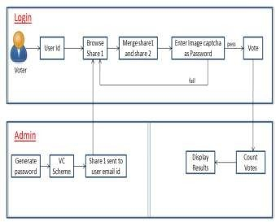
SYSTEM ARCHITECTURE

Slide 11
DATABASE
The data Requirments is very high for the project.The project include a database.Adatabase is created it’s name is Evoting.There are 9 tables.They are:
. campaign
candidates
guidelines
key
login
post
result publish
user
. vote

Slide 12
FUTURE SCOPE
The cryptographic online voting system overcomes restrictions on the traditional voting system. This system offers more safety and takes a while. There is also no chance of voting fraud. There is a significant reduction in the money spent on security. This method aims primarily to provide full privacy to voters and to ensure that the online voting system is coordinated optimally. The fundamental idea of this system is to use a strong voting authentication security mechanism. Visual encryption encrypts information and can decrypt it without mathematical calculations. People with an internet connection at home can vote at the polls without any problems. Visual cryptography is used to conduct elections fairly easily and efficiently using these internet-based voting systems since voters can vote from the point of view in which they operate using the online voting system.
Various advantages include low costs and increased voting attendance online voting. Online voting offers This online voting system takes careful account of safety and human factors, and in particular, ensures that the electorate has reliable and intuitive indications on the validity of the vote. The system we proposed to provide voters with mutual authentication and choosing with visual encryption.

Slide 13

SCREENSHOTS

Slide 14
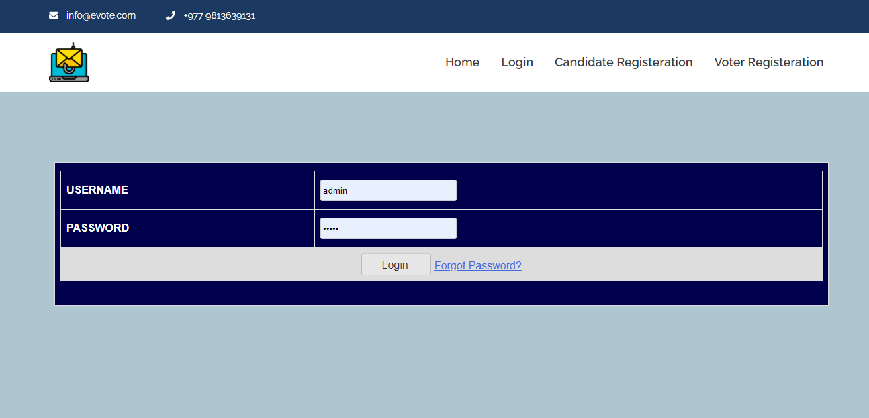

Slide 15
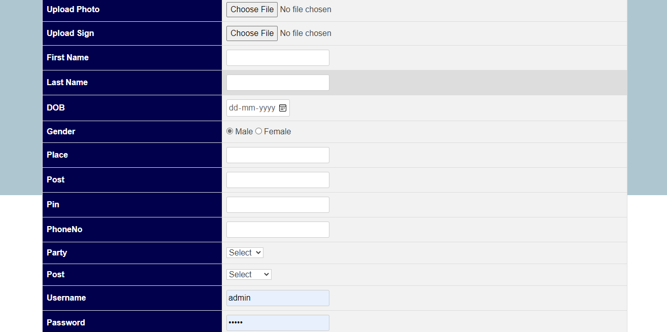

Slide 16
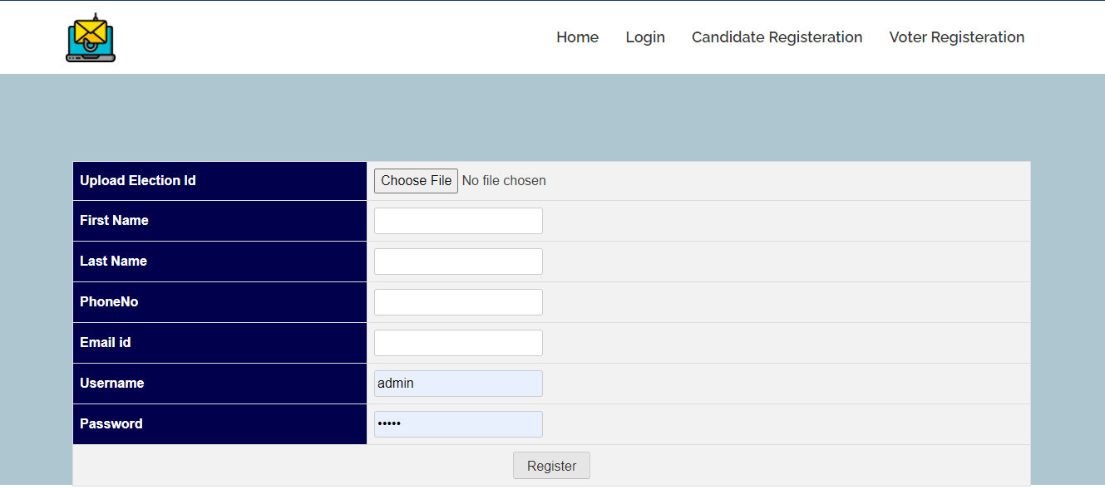

Slide 17
THANK YOU

